Slide 1


Data Tagging System for UW–Madison Transportation Services
Presented by:
Krish Prakash BHAT
Rohini Ramesh
Srivarshini Ankaiah Krishnappa
Zhongchao Pan
Ziyue Li

Slide 2



Project Introduction
Scan to access our GitHub repository
Centralized Tagging System
Introduces a centralized tagging system to unify campus contextual data.
Enhanced Decision-Making
Supports forecasting, planning, and operational decision-making for Transportation Services.
Historical Context
Provides historical context for understanding event-day traffic, parking demand, and operational impacts.

Slide 3


The Problem: Lack of Unified Data Structure
UW–Madison Transportation Services currently lacks a cohesive, unified structure to identify comparable historical days, leading to several critical issues:
Data Silos
Impact Tracing
Anomaly Explanation
Critical operational data is stored in isolated systems, preventing a holistic view.
Difficulty in tracing the specific impacts of events, weather conditions, or academic schedules.
Challenges in understanding and explaining anomalies observed in traffic and parking data.

Slide 4

Why This Matters: Consequences of Fragmented Data
Reactive Forecasting
Without central tagging, forecasting becomes purely reactive, missing opportunities for proactive planning.
Inefficient Preparation
Staffing and event preparation are inefficient due to the absence of clear contextual data.
Context-Poor Analysis
Demand analysis lacks vital context, leading to incomplete or misleading insights.
Slow Decision-Making
Operational decision-making is significantly slowed, impacting responsiveness and effectiveness.

Slide 5

Project Goal: A Centralized, User-Friendly Tagging System
Our primary objective is to develop an intuitive, calendar-based tagging system designed to centralize and streamline data management for UW–Madison Transportation Services.
01
Centralized Categories
Consolidate all relevant data categories: events, weather, closures, sports, and academic schedules.
02
Intuitive Interaction
Enable easy, user-friendly browsing and tagging functionality through an interactive calendar
interface.
03
Robust Backend
Connect the system to a structured Node.js + MySQL backend for reliable data storage and
retrieval.
04
Reporting Integration
Integrate datasets with Power BI for comprehensive and dynamic reporting.

Slide 6

Key Data Sources Utilized
To build a comprehensive and accurate tagging system, we integrated data from several critical sources:
Weather data (Daily conditions 2020–2024)
Parking occupancy (Lots 17 & 76 historical data)
Campus closures
Parking restrictions
UW athletics & campus events (merged into events table)
Custom tags (created through the UI)
Academic Calendars (2020–2024)

Slide 7
System Architecture: A Step-by-Step Approach
6. Analytics Integration (Power BI)
Connecting the Railway MySQL database directly to Power BI to support operational insights.
5. Tag Logic Rendering
Implementing rules for displaying events, weather, closures, parking, and custom tags.
4. Interactive Calendar UI
Building the user-facing calendar interface for viewing events and tags.
3. Backend Setup
Connecting a locally hosted Node.js API to the Railway MySQL database.
2. Schema + ERD Design
Designing the MySQL database structure, relationships, and unified date_key.
1. Data Collection & Cleaning
Gathering and preparing all necessary datasets.

Slide 8














Database Schema: Relational Design
Our database is designed with a fully relational structure centered around a unified date_key, enabling consistent linking across all datasets and efficient querying for analysis.
Tags
Dates
Categorizes various events and conditions.
(Exists locally)
Core entity, linking all other data.
Sports
Details about athletic events.
Occupancy
Parking lot usage data.
Weather
Historical weather conditions.
Road Closures
Academic Calendar
Information on road disruptions.
University academic schedule.

Slide 9
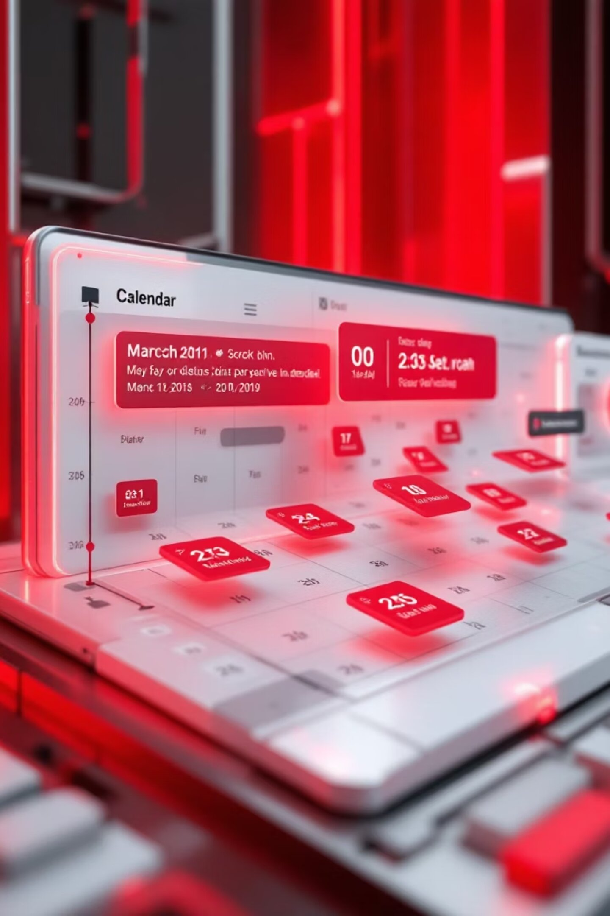
Interactive Calendar Interface: Demo Concept
The user interface is designed for maximum usability and responsiveness, built with TailwindCSS to ensure a modern and adaptable experience across devices.
1
Multi-Year View
Browse dates from 2020 to 2024 with ease.
2
Tag Category Filters
Quickly narrow down views by specific tag types.
3
Metadata Modal
Click any date to reveal detailed metadata.
4
Custom tag creation
Add new contextual tags directly from interface.

Slide 10
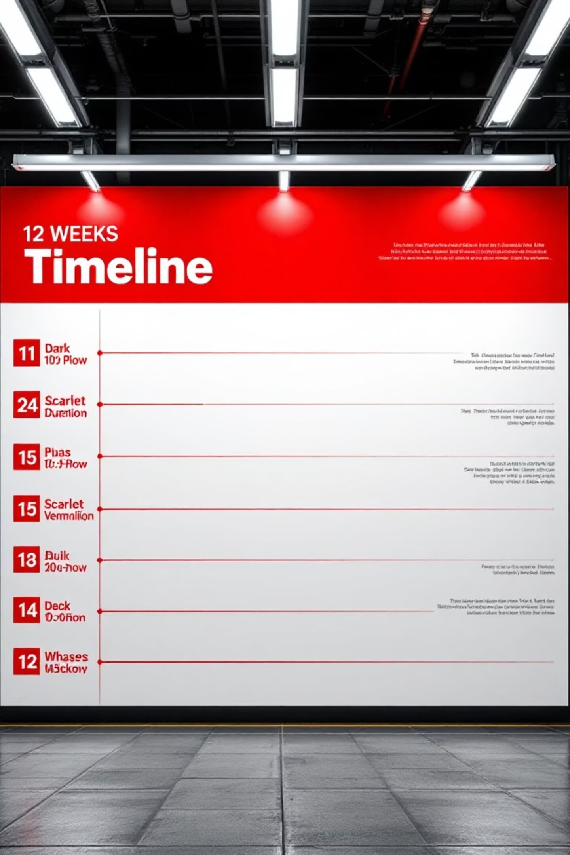
Project Development Timeline
Weeks 1–3
Requirements Gathering & Data Collection
Weeks 4–7
Database Schema Design & Dataset Construction
Weeks 8–10
UI Development & Backend Integration
Weeks 11–12
Comprehensive Testing, Documentation, & Final Handoff

Slide 11






Key Accomplishments: Bringing Data to Life
Cleaned & Standardized Datasets
Developed Node.js + MySQL Backend
Transformed disparate data into a coherent, usable format, laying a robust foundation for the entire system.
Engineered a backend API using Node.js connected to a cloud-hosted MySQL database on Railway, enabling structured data retrieval and reliable date-based tagging.
Designed & Validated ERD
Developed Interactive Calendar UI
Developed a comprehensive Entity-Relationship Diagram, crucial for understanding and managing data relationships effectively.
Created an intuitive and dynamic user interface, enabling easy visualization and interaction with tagged data.
Connected UI to Backend API
Implemented Tag Rendering Logic
Integrated the interactive calendar with the Node.js API, enabling fetching of events, closures, weather, parking data, and custom tags via planned backend syncing from the MySQL database.
Designed logic to display and prioritize multiple tag
categories events, closures, weather, parking restrictions, and
user-created tags, ensuring clarity & accuracy in the UI.

Slide 12

Navigating the Hurdles: Challenges & Limitations
1
Dataset Inconsistencies
Significant variability across multiple source datasets required extensive cleaning, standardization, and validation to ensure accuracy and compatibility.
2
Schema & Data Alignment
Aligning diverse datasets under a unified date_key structure required careful restructuring, ensuring consistent relationships across events, weather, closures, and parking data.
3
Time Complexity with Large Data
Processing large datasets and optimizing MySQL queries demanded thoughtful design decisions to maintain smooth performance and fast data retrieval.
4
4
Hosting Limitations
Although deployed on Railway, updates made through the interface remain device-local and do not sync across users.
4

Slide 13


Rigorous Evaluation & Testing
Evaluation Focus Areas:
Schema alignment & validation of unified date_key
UI usability & responsiveness
Tag rendering accuracy
API reliability & MySQL connection stability
Multi-year coverage (2020–2024) testing
Validation Outcome:
Our rigorous testing protocols confirmed that all core functions of the data-tagging and calendar prototype are fully validated and performing as expected.
Confidence in Core Functionality: The prototype successfully passed all critical evaluation points, ensuring reliability and accuracy.

Slide 14





Charting the Course: Future Work
Expanded Power BI Dashboard Development
Enhancing Power BI dashboards with additional insights, trend analysis, and facility-level comparisons.
Predictive Tagging using ML
Implementing machine learning algorithms to automate and enhance the accuracy of data tagging, anticipating future needs.
API Integrations
Connecting with external APIs for data from construction projects, athletics schedules, and real-time weather, enriching the tagging data.
Permission-Based Role Management
Developing a secure role-based access control system to manage user permissions and data visibility effectively.
Recurring Auto-Tagging
Establishing automated processes for recurring events, such as weekly games, to ensure consistent and timely data updates.

Slide 15




Team Reflections: The Journey and Learnings
Working with Real Operational Data
The opportunity to engage with authentic, real-world data provided invaluable practical experience and insights.
Full-Stack Development Experience
Gaining hands-on experience across both frontend and backend development was a significant learning curve and highly rewarding.
UI/UX + Database Integration
Successfully integrating user interface design with robust database architecture was a complex but satisfying achievement.
Seeing Calendar Visualize Real Tags
Witnessing the interactive calendar effectively display and organize real data tags was incredibly motivating and demonstrated the project's impact.

Slide 16

Lessons Learned: What We'd Do Differently
Start Schema & date_key Design Earlier
Finalizing the unified date_key structure earlier would have streamlined database mapping and reduced dataset rework.
Standardize Datasets Upfront
Investing more time in early data standardization would have mitigated many of the inconsistencies encountered during development.
Clarify Analytics Platform Expectations Earlier
Gaining clearer alignment on Power BI integration requirements from the outset would have improved planning and resource allocation.
More Time for UI Polishing
Allocating additional time for user interface refinement would have led to an even more polished and user-friendly experience.
Validate Platform Compatibility Early
Switching between MySQL and Supabase due to firewall barriers and Power BI limitations emphasized the need to validate hosting platforms and analytics tools early in the project lifecycle

Slide 17








Final Takeaways: Impact and Potential
Unified Tagging System
Intuitive Calendar UI
A cohesive date-based tagging system improves campus-wide decision-making through better organization and integration of contextual data.
Non-technical staff can effortlessly navigate and utilize the calendar, fostering broader adoption and impact.
Strong Foundation for Expansion
Scalable & Cloud-Ready Backend
This prototype provides a solid, adaptable framework for extending data-tagging capabilities across the entire university campus.
With a cloud-hosted MySQL database and modular Node.js architecture, the system is positioned for future full backend deployment and scalable growth.

Slide 18

Thank You
Questions?
We appreciate your time and attention. Please feel free to ask any questions you may have.

